Slide 1
COMP 2710 Software Construction
Function Basics 2
Function Overloading
Dr. Alvin Lim
Auburn University
http://www.eng.auburn.edu/~lim
limalvi@auburn.edu
Fall 2014
These slides are adapted from notes by Dr. Walter Savitch (UCSD)
Notes:
See Lecture 3
Objectives
Predefined Functions
Those that return a value and those that don’t
Programmer-defined Functions
Defining, Declaring, Calling
Recursive Functions
Scope Rules
Local variables
Global constants and global variables
Blocks, nested scopes

Slide 2
Declaring Void Functions
Similar to functions returning a value
Return type specified as "void"
Example:
  Function declaration/prototype:
  void showResults(double fDegrees,
  double cDegrees);
    Return-type is "void"
    Nothing is returned
Copyright © 2008 Pearson Addison-Wesley. All rights reserved.
3-<number>

Slide 3
Declaring Void Functions
Function definition:
void showResults(double fDegrees,
double cDegrees)
{
cout.setf(ios::fixed);
cout.setf(ios::showpoint);
cout.precision(1);
cout << fDegrees
<< " degrees fahrenheit equals \n"
<< cDegrees << " degrees celsius.\n";
}
Notice: no return statement
  Optional for void functions
Copyright © 2008 Pearson Addison-Wesley. All rights reserved.
3-<number>

Slide 4
Calling Void Functions
Same as calling predefined void functions
From some other function, like main():
  showResults(degreesF, degreesC);
  showResults(32.5, 0.3);
Notice no assignment, since no
value returned
Actual arguments (degreesF, degreesC)
  Passed to function
  Function is called to "do it’s job" with the
  data passed in
Copyright © 2008 Pearson Addison-Wesley. All rights reserved.
3-<number>

Slide 5
More on Return Statements
Transfers control back to "calling" function
  For return type other than void, MUST have
  return statement
  Typically the LAST statement in
  function definition
return statement optional for void functions
  Closing } would implicitly return control from
  void function
Copyright © 2008 Pearson Addison-Wesley. All rights reserved.
3-<number>

Slide 6
Preconditions and Postconditions
Similar to "I-P-O" discussion
Comment function declaration:
void showInterest(double balance, double rate);
//Precondition: balance is nonnegative account balance
// rate is interest rate as percentage
//Postcondition: amount of interest on given balance,
// at given rate …
Often called Inputs & Outputs
Copyright © 2008 Pearson Addison-Wesley. All rights reserved.
3-<number>

Slide 7
main(): "Special"
Recall: main() IS a function
"Special" in that:
  One and only one function called main()
  will exist in a program
Who calls main()?
  Operating system
  Tradition holds it should have return statement
    Value returned to "caller" → Here: operating system
  Should return "int" or "void"
Copyright © 2008 Pearson Addison-Wesley. All rights reserved.
3-<number>

Slide 8
Scope Rules
Local variables
  Declared inside body of given function
  Available only within that function
Can have variables with same names declared in different functions
  Scope is local: "that function is it’s scope"
Local variables preferred
  Maintain individual control over data
  Need to know basis
  Functions should declare whatever local data needed to "do their job"
Copyright © 2008 Pearson Addison-Wesley. All rights reserved.
3-<number>

Slide 9
Procedural Abstraction
Need to know "what" function does, not
"how" it does it!
Think "black box"
  Device you know how to use, but not it’s
  method of operation
Implement functions like black box
  User of function only needs: declaration
  Does NOT need function definition
    Called Information Hiding
    Hide details of "how" function does it’s job
Copyright © 2008 Pearson Addison-Wesley. All rights reserved.
3-<number>

Slide 10
Global Constants and Global Variables
Declared "outside" function body
  Global to all functions in that file
Declared "inside" function body
  Local to that function
Global declarations typical for constants:
  const double TAXRATE = 0.05;
  Declare globally so all functions have scope
Global variables?
  Possible, but SELDOM-USED
  Dangerous: no control over usage!
Copyright © 2008 Pearson Addison-Wesley. All rights reserved.
3-<number>

Slide 11
Blocks
Declare data inside compound statement
  Called a "block"
  Has "block-scope"
Note: all function definitions are blocks!
  This provides local "function-scope"
Loop blocks:
for (int ctr=0;ctr<10;ctr++)
{
sum+=ctr;
}
  Variable ctr has scope in loop body block only
Copyright © 2008 Pearson Addison-Wesley. All rights reserved.
3-<number>

Slide 12
Nested Scope
Same name variables declared in
multiple blocks
Very legal; scope is "block-scope"
  No ambiguity
  Each name is distinct within its scope
Copyright © 2008 Pearson Addison-Wesley. All rights reserved.
3-<number>

Slide 13
Summary
Local data
  Declared in function definition
Global data
  Declared above function definitions
  OK for constants, not for variables
Parameters/Arguments
  Formal: In function declaration and definition
    Placeholder for incoming data
  Actual: In function call
    Actual data passed to function
Copyright © 2008 Pearson Addison-Wesley. All rights reserved.
3-<number>

Slide 14
Function Overloading
Copyright © 2008 Pearson Addison-Wesley. All rights reserved.
4-<number>

Slide 15
Overloading
Same function name
Different parameter lists
Two separate function definitions
Function "signature"
  Function name & parameter list
  Must be "unique" for each function definition
Allows same task performed on different data
Copyright © 2008 Pearson Addison-Wesley. All rights reserved.
4-<number>

Slide 16
Overloading Example: Average
Function computes average of 2 numbers:
double average(double n1, double n2)
{
return ((n1 + n2) / 2.0);
}
Now compute average of 3 numbers:
double average(double n1, double n2, double n3)
{
return ((n1 + n2 + n3) / 3.0);
}
Same name, two functions
Copyright © 2008 Pearson Addison-Wesley. All rights reserved.
4-<number>

Slide 17
Overloaded Average() Cont’d
Which function gets called?
Depends on function call itself:
  avg = average(5.2, 6.7);
    Calls "two-parameter average()"
  avg = average(6.5, 8.5, 4.2);
    Calls "three-parameter average()"
Compiler resolves invocation based on
signature of function call
  "Matches" call with appropriate function
  Each considered separate function
Copyright © 2008 Pearson Addison-Wesley. All rights reserved.
4-<number>

Slide 18
Overloading Pitfall
Only overload "same-task" functions
  A mpg() function should always perform
  same task, in all overloads
  Otherwise, unpredictable results
C++ function call resolution:
  1st: looks for exact signature
  2nd: looks for "compatible" signature
Copyright © 2008 Pearson Addison-Wesley. All rights reserved.
4-<number>

Slide 19
Overloading Resolution
1st: Exact Match
  Looks for exact signature
    Where no argument conversion required
2nd: Compatible Match
  Looks for "compatible" signature where
  automatic type conversion is possible:
    1st with promotion (e.g., int→double)
      No loss of data
    2nd with demotion (e.g., double→int)
      Possible loss of data
Copyright © 2008 Pearson Addison-Wesley. All rights reserved.
4-<number>

Slide 20
Overloading Resolution Example
Given following functions:
  1. void f(int n, double m);
  2. void f(double n, int m);
  3. void f(int n, int m);
  These calls:
  f(98, 99); → Calls #3
  f(5.3, 4); → Calls #2
  f(4.3, 5.2); → Calls ???
Avoid such confusing overloading
Copyright © 2008 Pearson Addison-Wesley. All rights reserved.
4-<number>

Slide 21
Automatic Type Conversion and Overloading
Numeric formal parameters typically
made "double" type
Allows for "any" numeric type
  Any "subordinate" data automatically promoted
    int → double
    float → double
    char → double *More on this later!
Avoids overloading for different numeric types
Copyright © 2008 Pearson Addison-Wesley. All rights reserved.
4-<number>

Slide 22
Automatic Type Conversion and Overloading Example
double mpg(double miles, double gallons)
{
return (miles/gallons);
}
Example function calls:
  mpgComputed = mpg(5, 20);
    Converts 5 & 20 to doubles, then passes
  mpgComputed = mpg(5.8, 20.2);
    No conversion necessary
  mpgComputed = mpg(5, 2.4);
    Converts 5 to 5.0, then passes values to function
Copyright © 2008 Pearson Addison-Wesley. All rights reserved.
4-<number>

Slide 23
Default Arguments
Allows omitting some arguments
Specified in function declaration/prototype
  void showVolume(int length,
  int width = 1,
  int height = 1);
    Last 2 arguments are defaulted
  Possible calls:
    showVolume(2, 4, 6); //All arguments supplied
    showVolume(3, 5); //height defaulted to 1
    showVolume(7); //width & height defaulted to 1
Copyright © 2008 Pearson Addison-Wesley. All rights reserved.
4-<number>

Slide 24
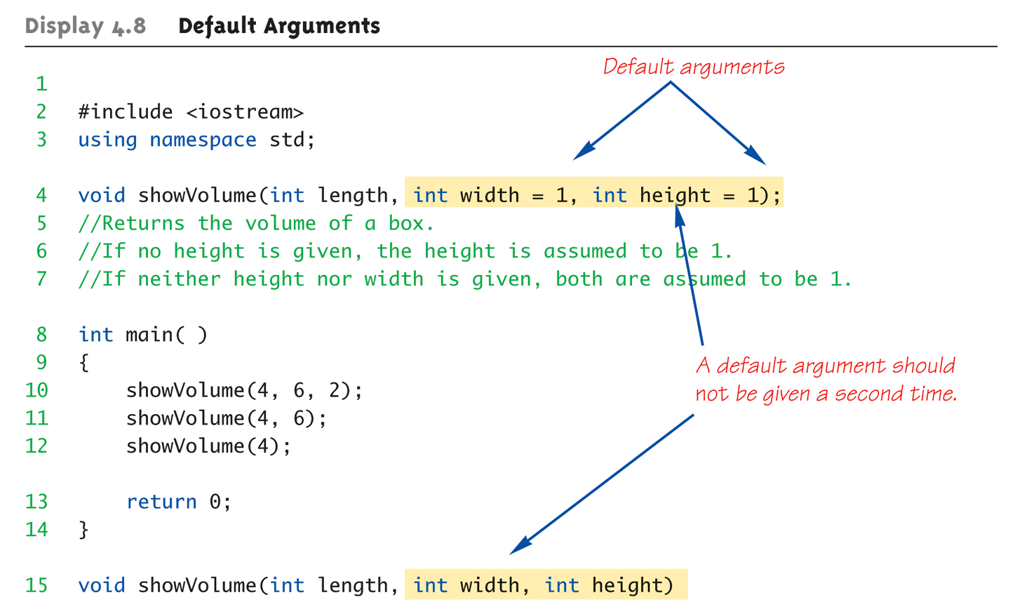
Default Arguments Example:
Display 4.1 Default Arguments (1 of 2)
Copyright © 2008 Pearson Addison-Wesley. All rights reserved.
4-<number>

Slide 25
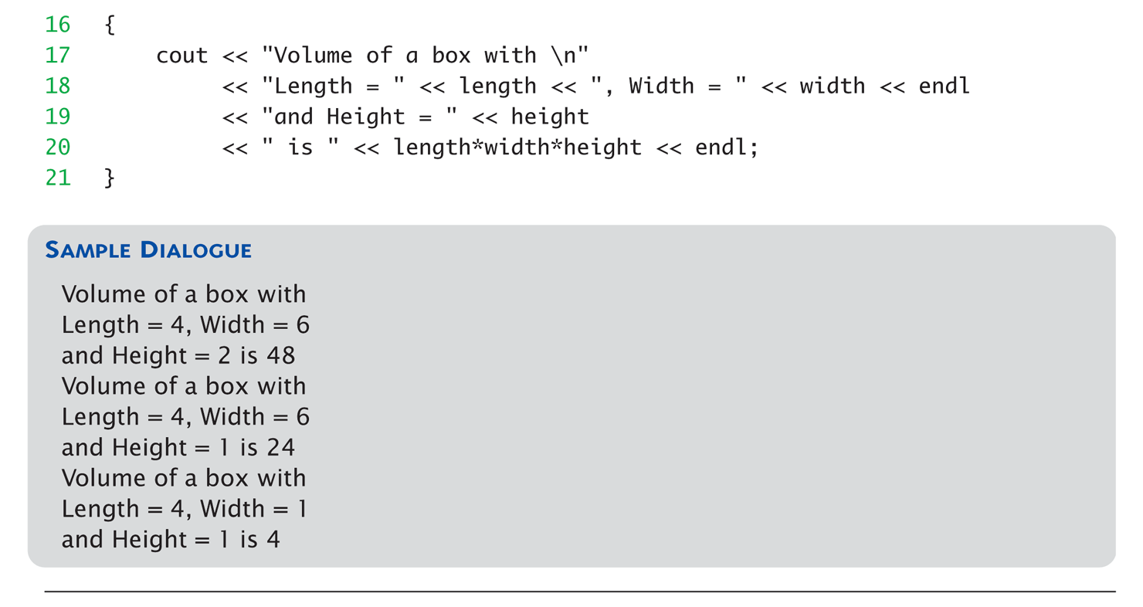
Default Arguments Example:
Display 4.1 Default Arguments (2 of 2)
Copyright © 2008 Pearson Addison-Wesley. All rights reserved.
4-<number>

Slide 26
Summary
Multiple definitions of same function name
possible: called overloading
Default arguments allow function call to
"omit" some or all arguments in list
  If not provided → default values assigned
Copyright © 2008 Pearson Addison-Wesley. All rights reserved.
4-<number>

